Slide 1
RANDOM FOREST
02-28-2019-WORKSHOP-INSIGHT DATA SCIENCE
DIEUDONNE OUEDRAOGO

Slide 2
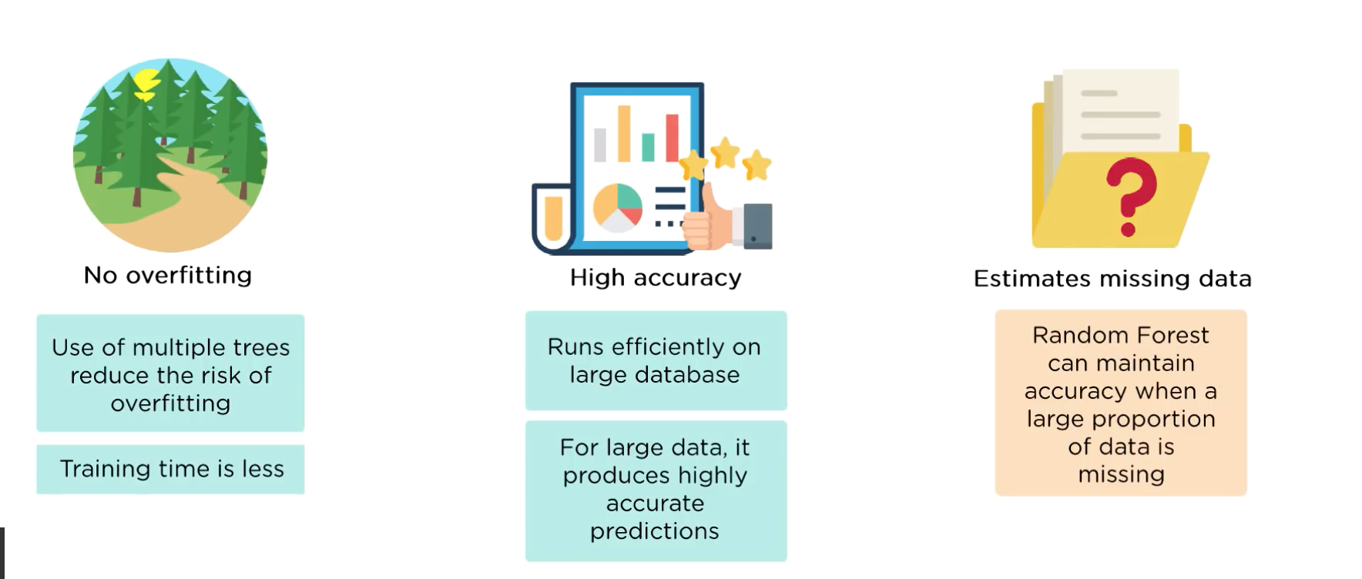
WHY WE USE RANDOM FOREST?

Slide 3
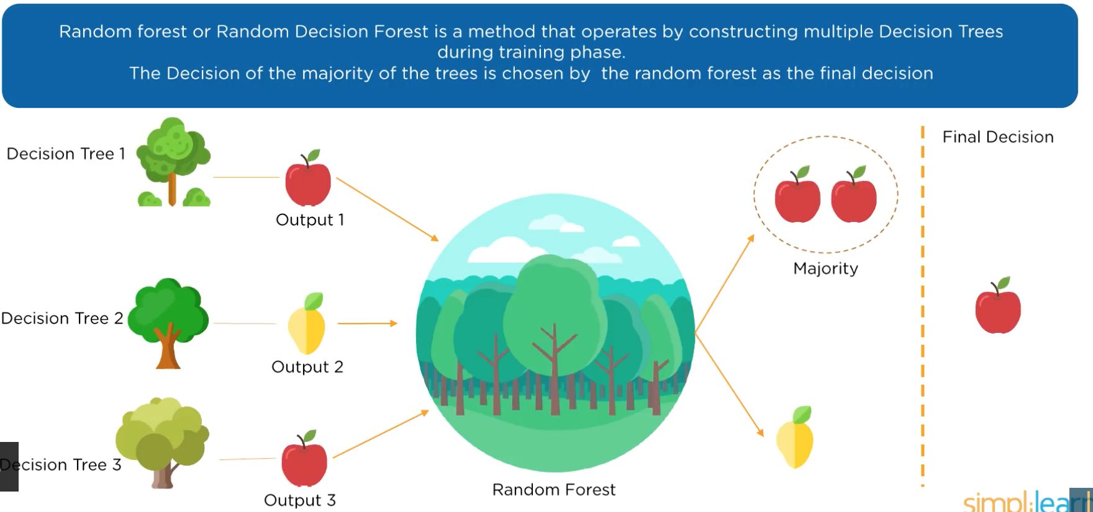
WHAT IS RANDOM FOREST
Decision Tree 3
Random Forest

Slide 4
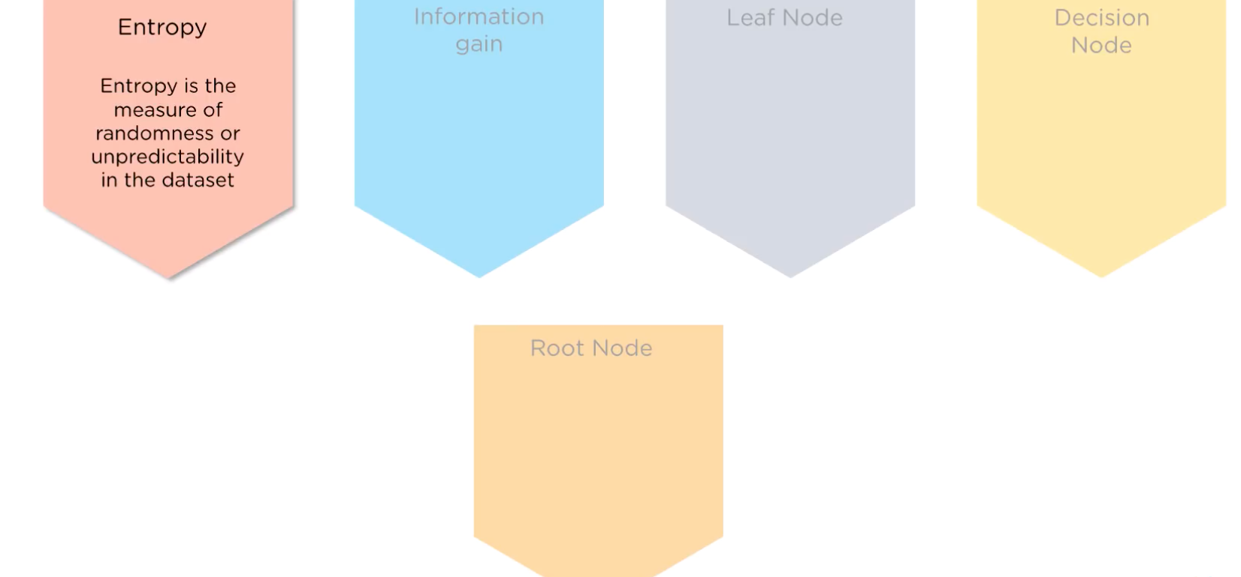
ENTROPY

Slide 5
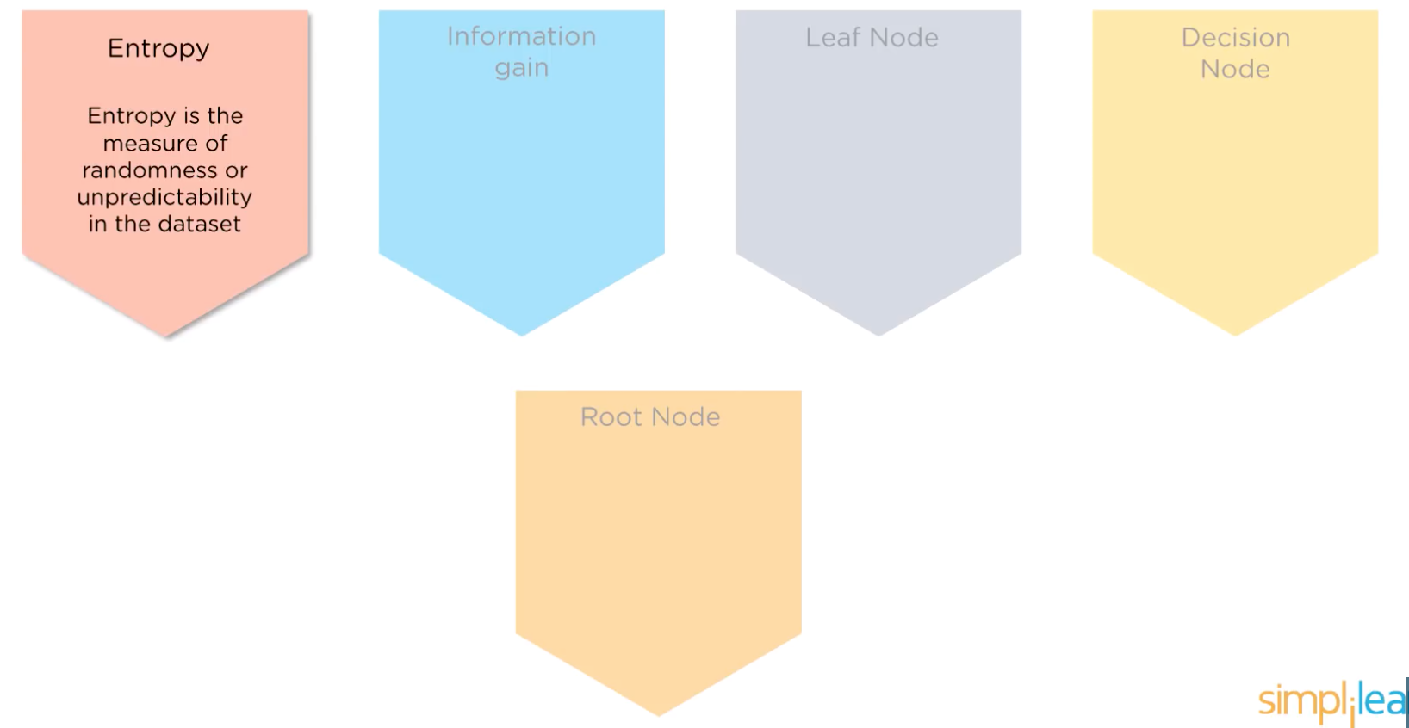
ENTROPY

Slide 6
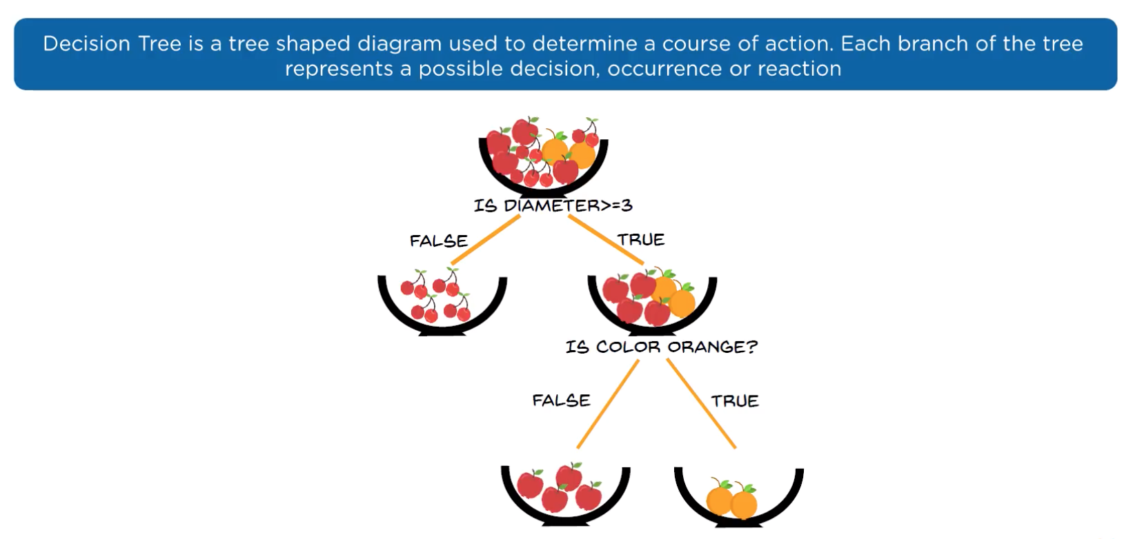
DECISION TREE

Slide 7
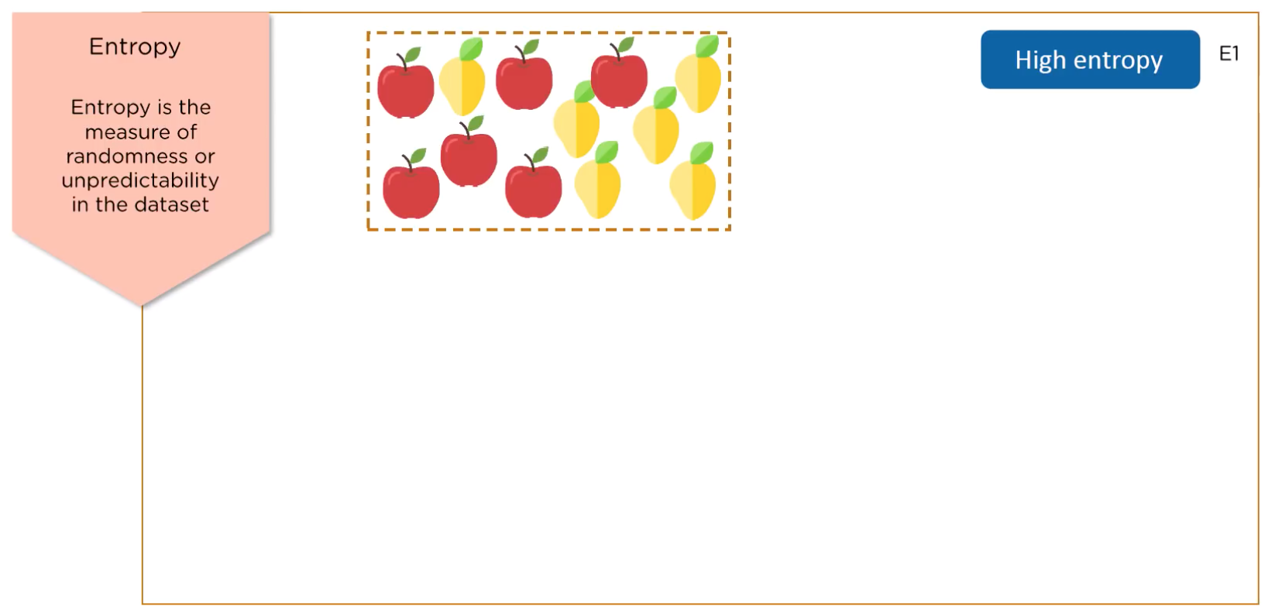
HIGH ENTROPY

Slide 8
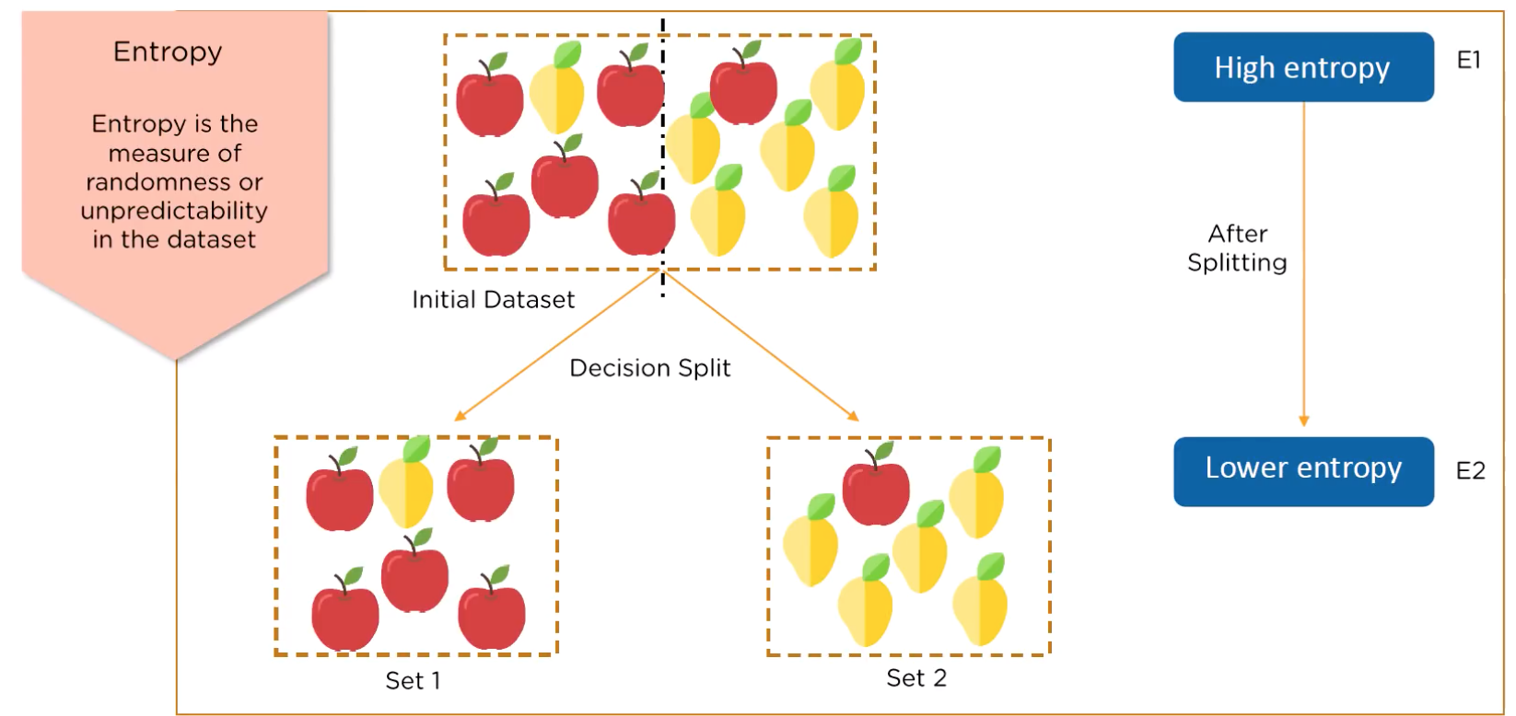
LOW ENTROPY

Slide 9
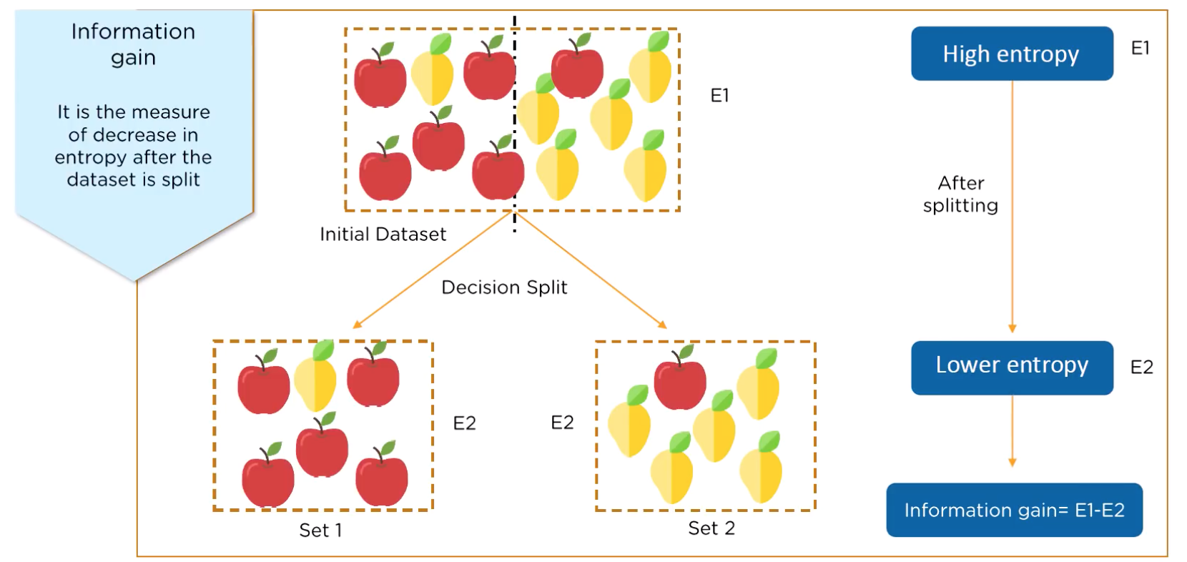
INFORMATION GAIN

Slide 10
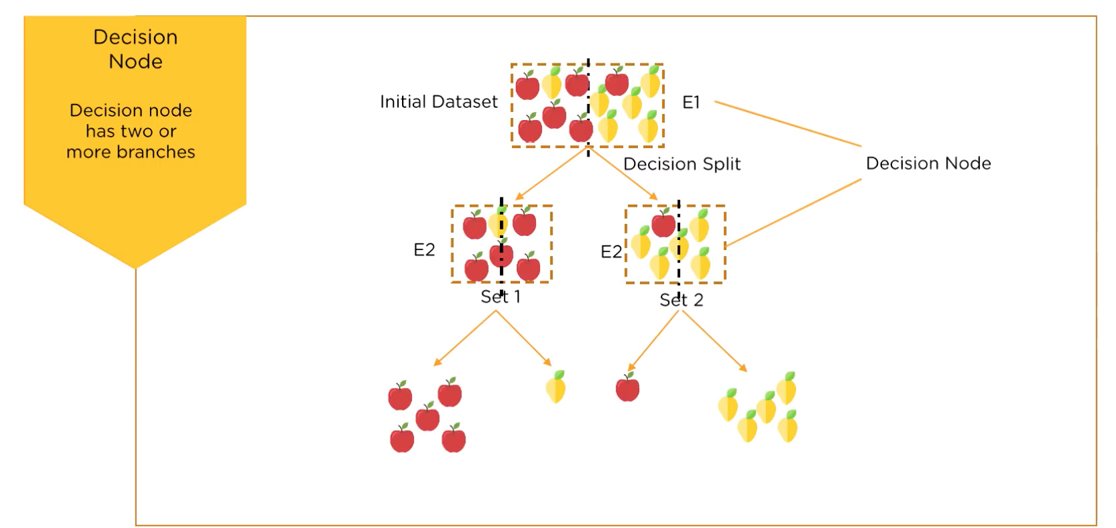
DECISION NODE

Slide 11
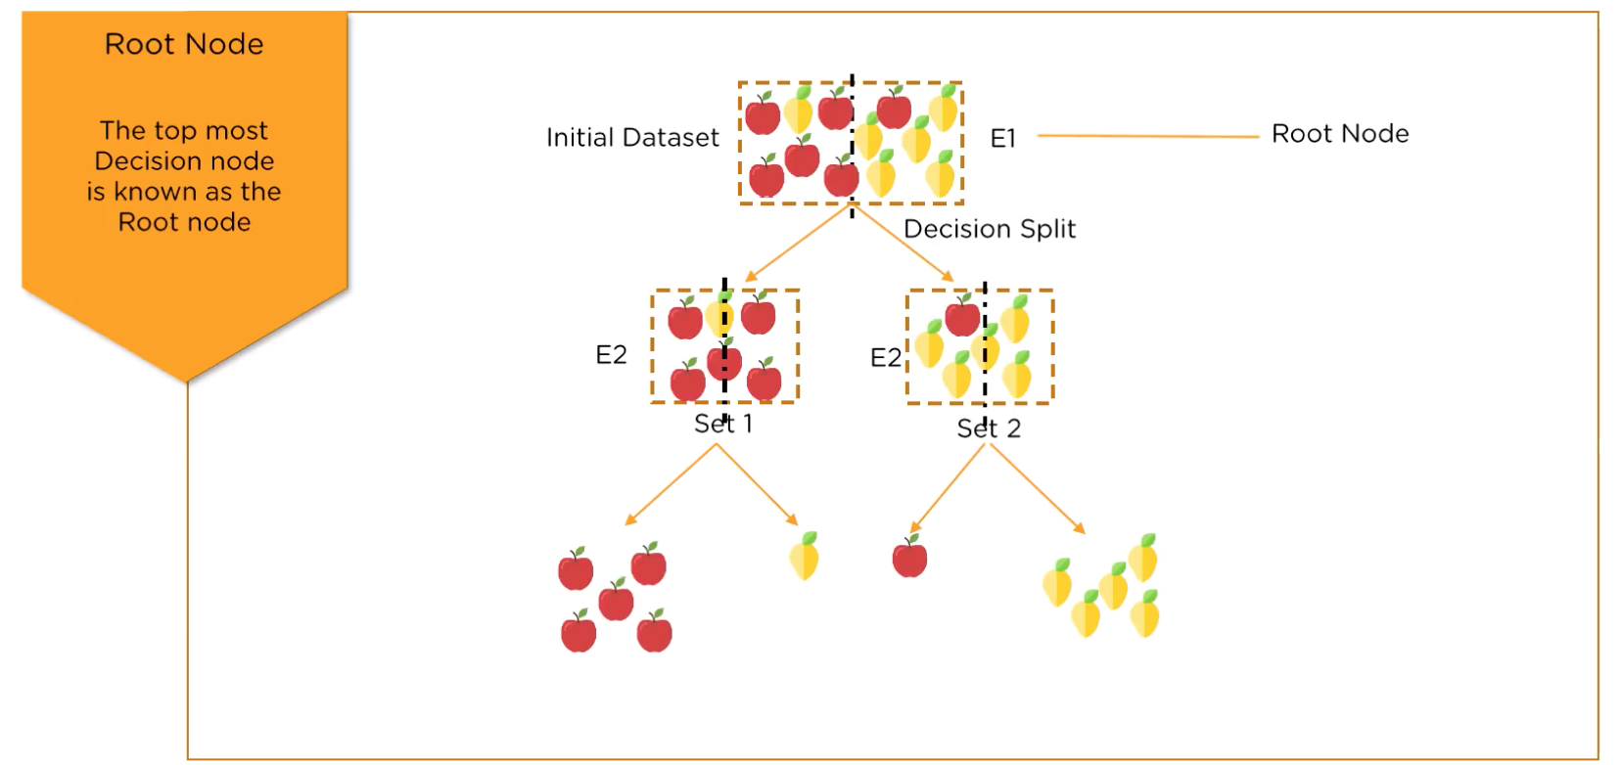
ROOT NODE

Slide 12
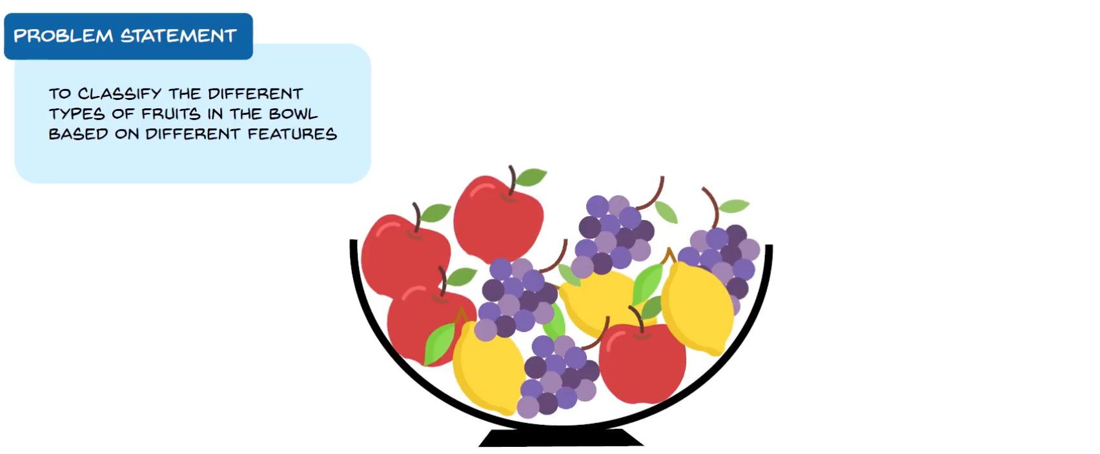
FRUITS CLASSIFICATION

Slide 13
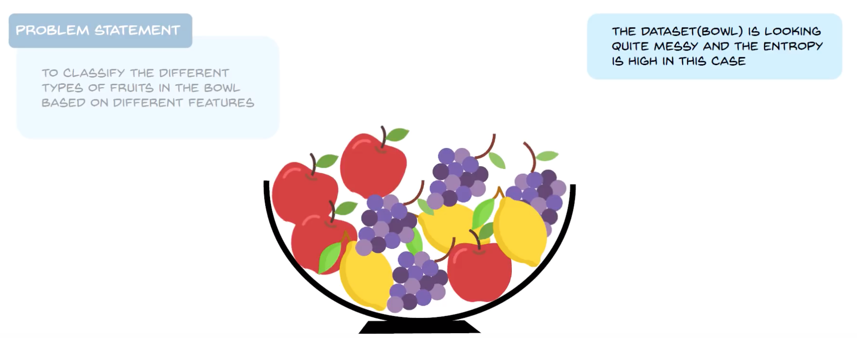
HIGH ENTROPY

Slide 14
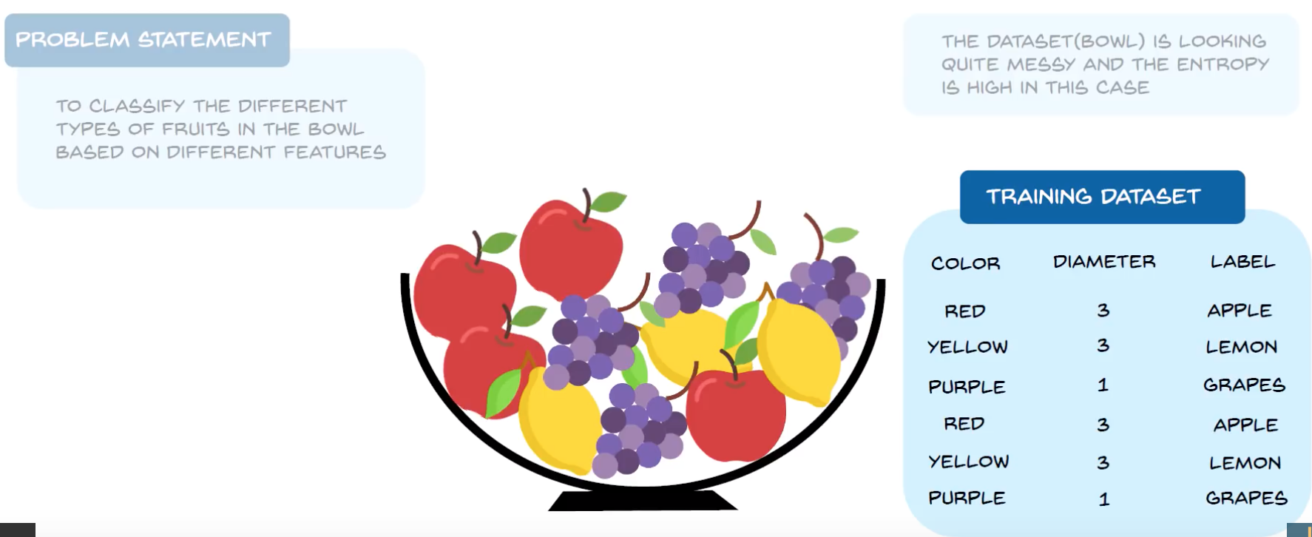
THE TRAINING DATASET

Slide 15
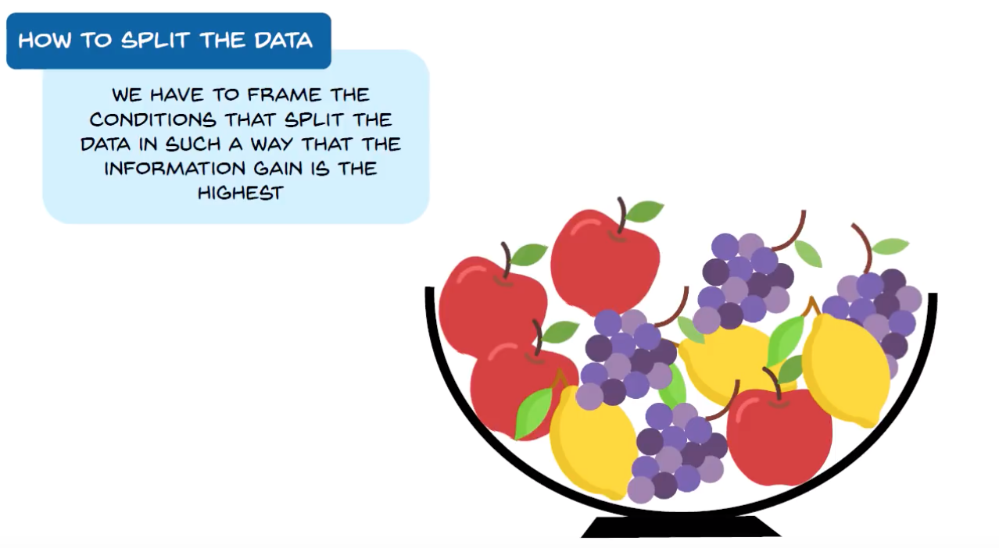
SPLITING THE DATASET

Slide 16
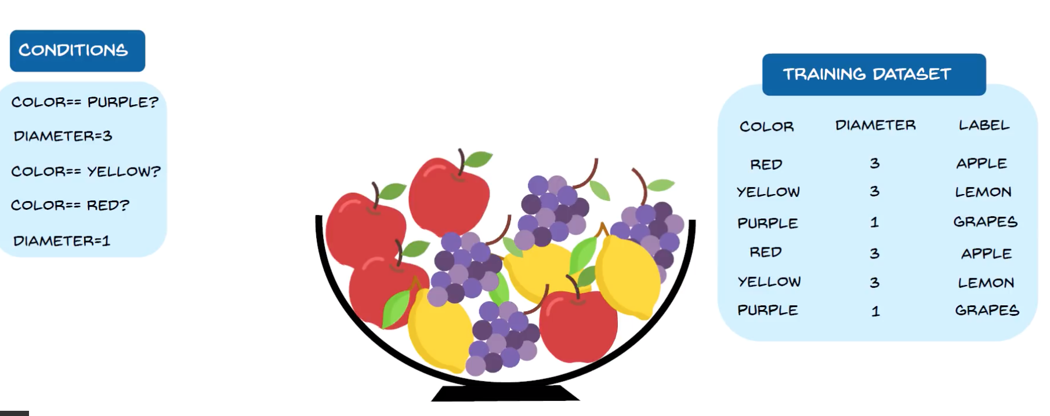
CONDITIONS ON SPLITING

Slide 17
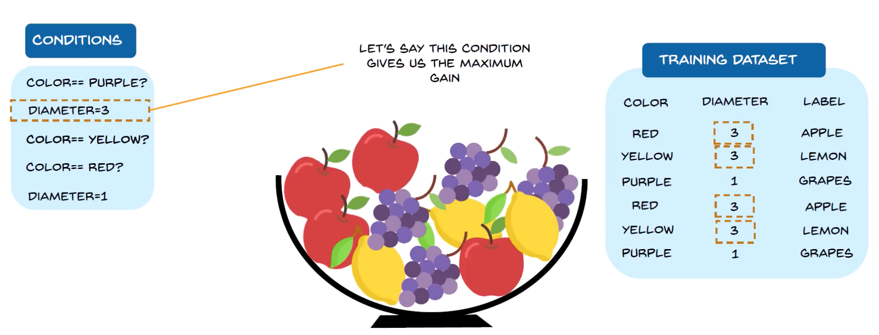
USING THE MAX INFORMATION GAIN

Slide 18
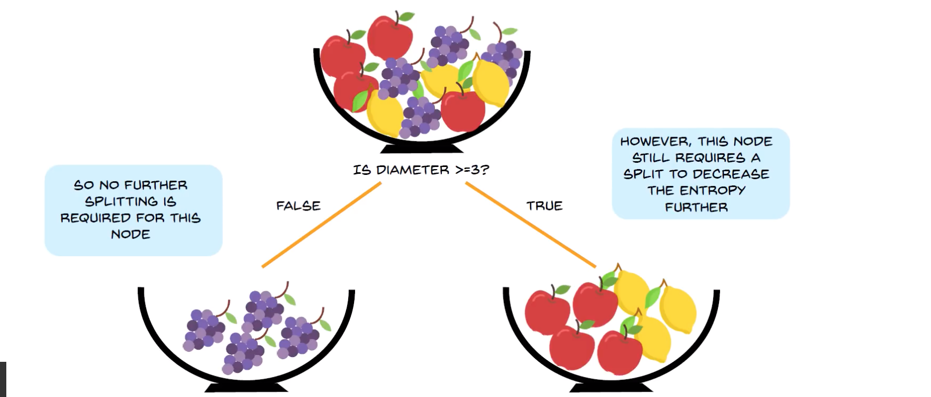
SPLIT BY DIAMETER SIZE

Slide 19
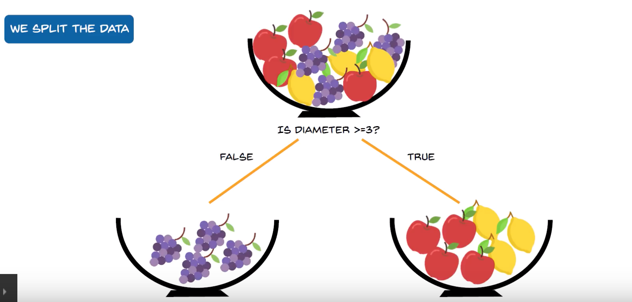
WE SPLIT

Slide 20
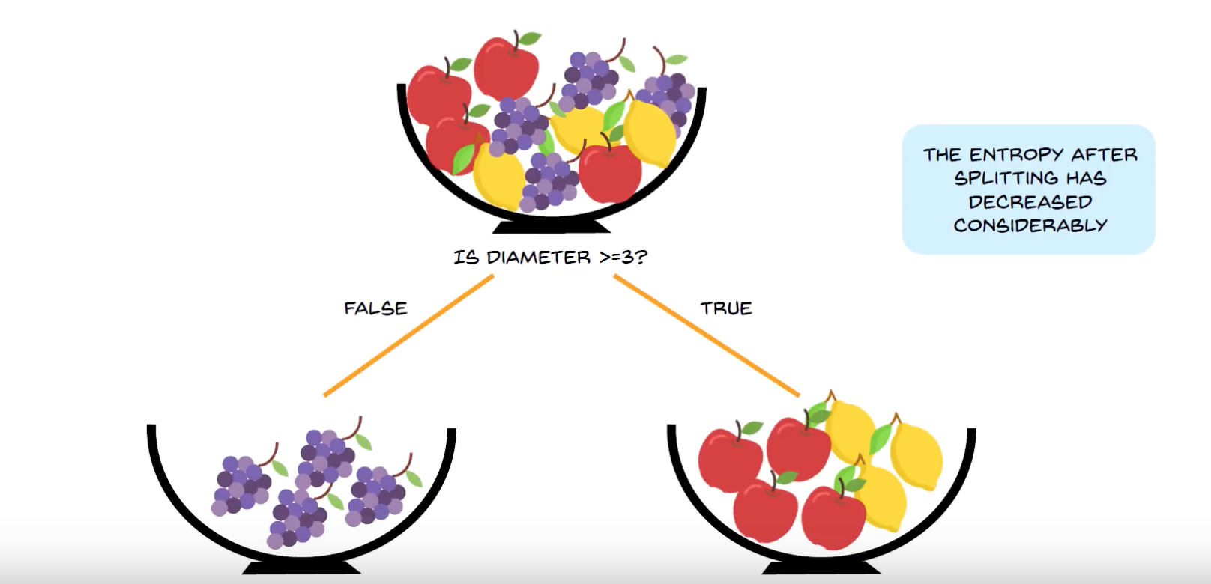
Entropy Decrease

Slide 21
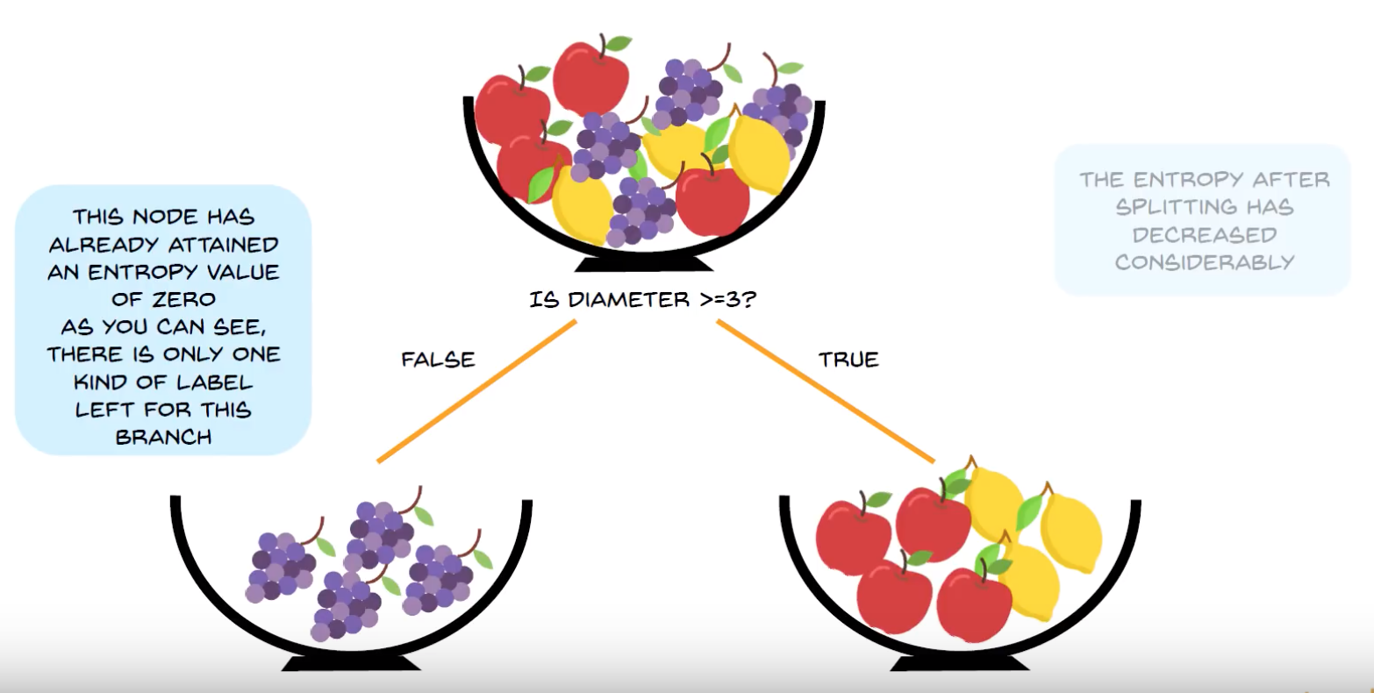

Slide 22
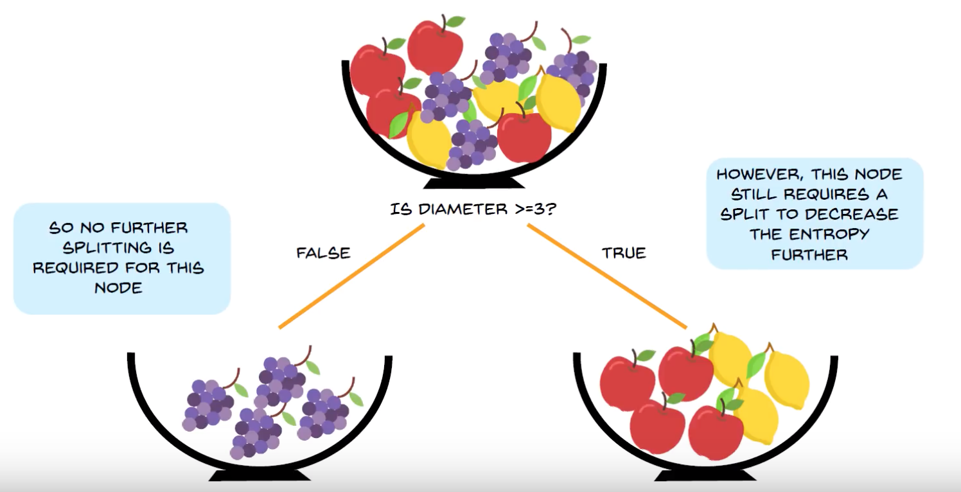

Slide 23
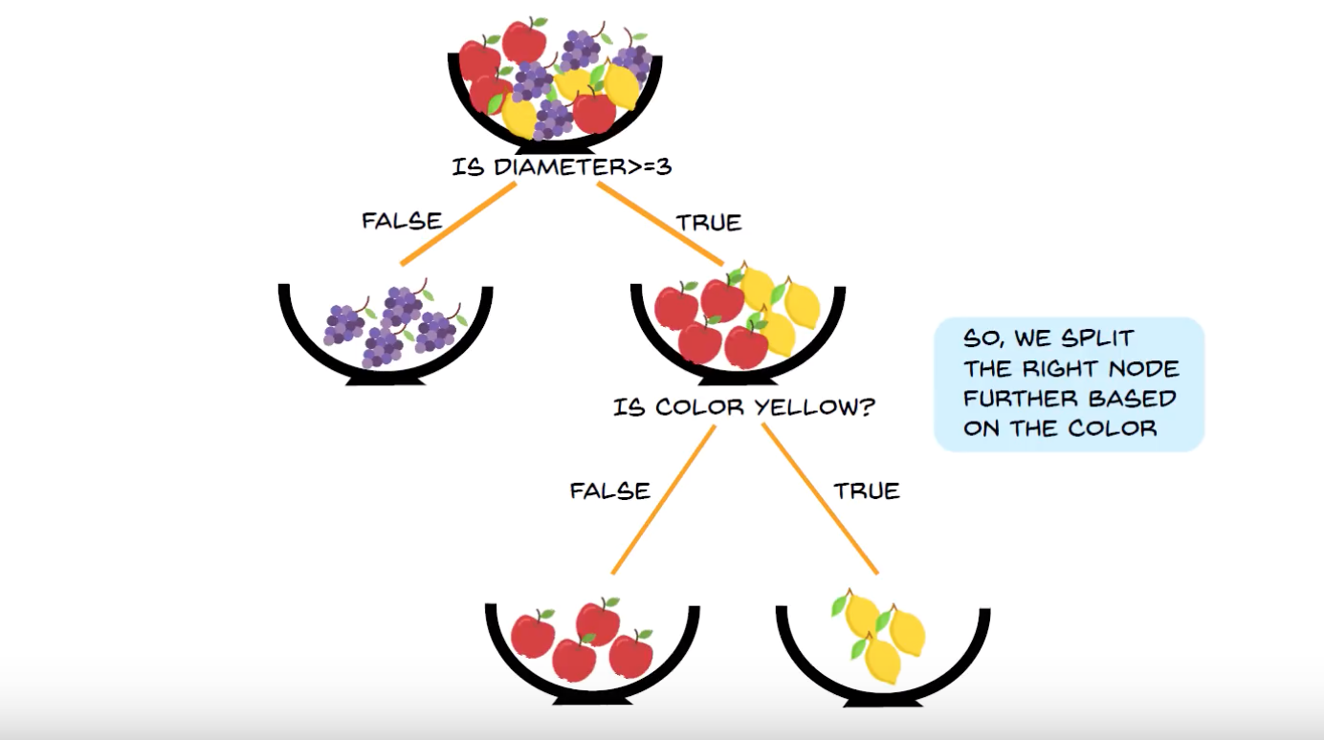
FINAL STEP

Slide 24
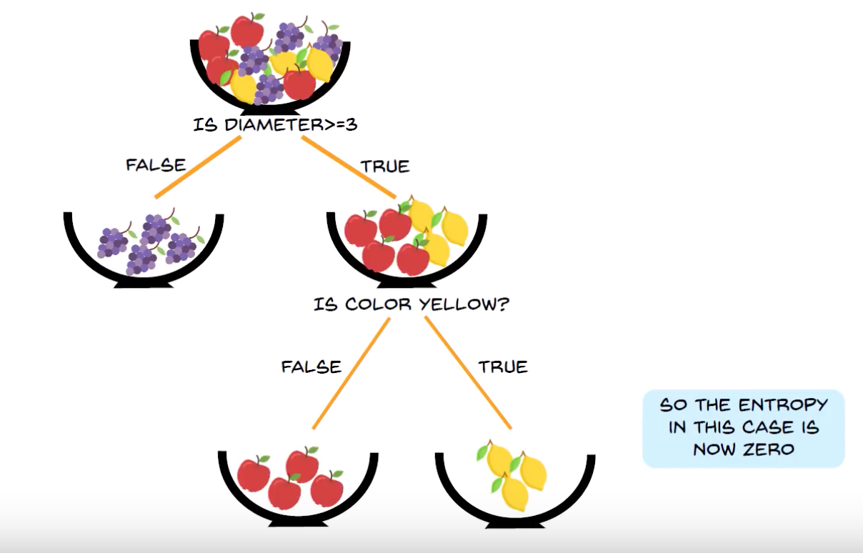
Entropy =0

Slide 26
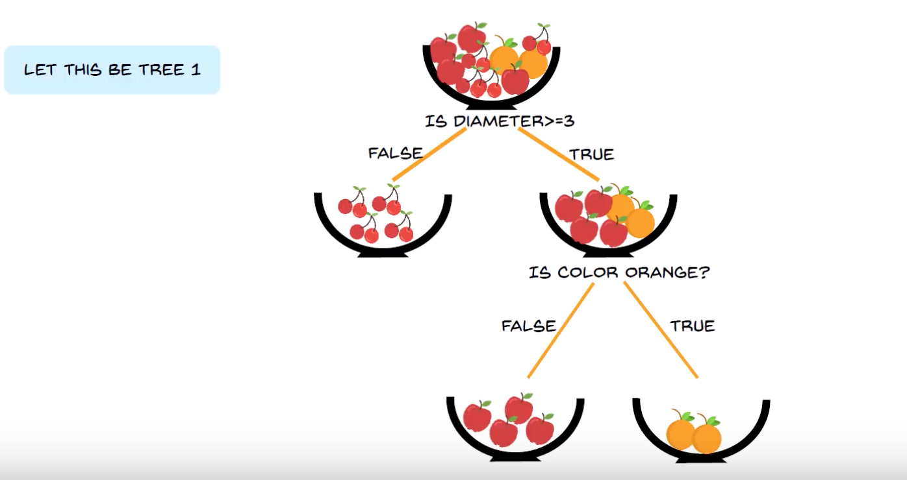
Berries Apples and Oranges

Slide 27
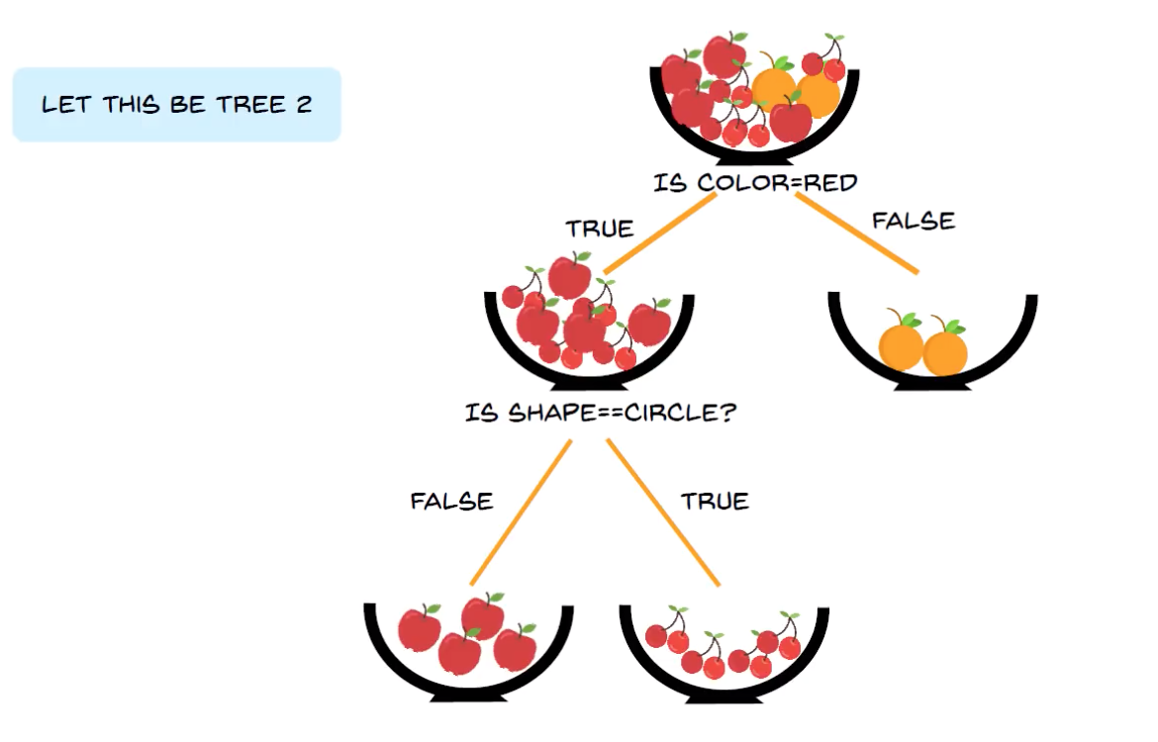
Decision tree 2

Slide 28
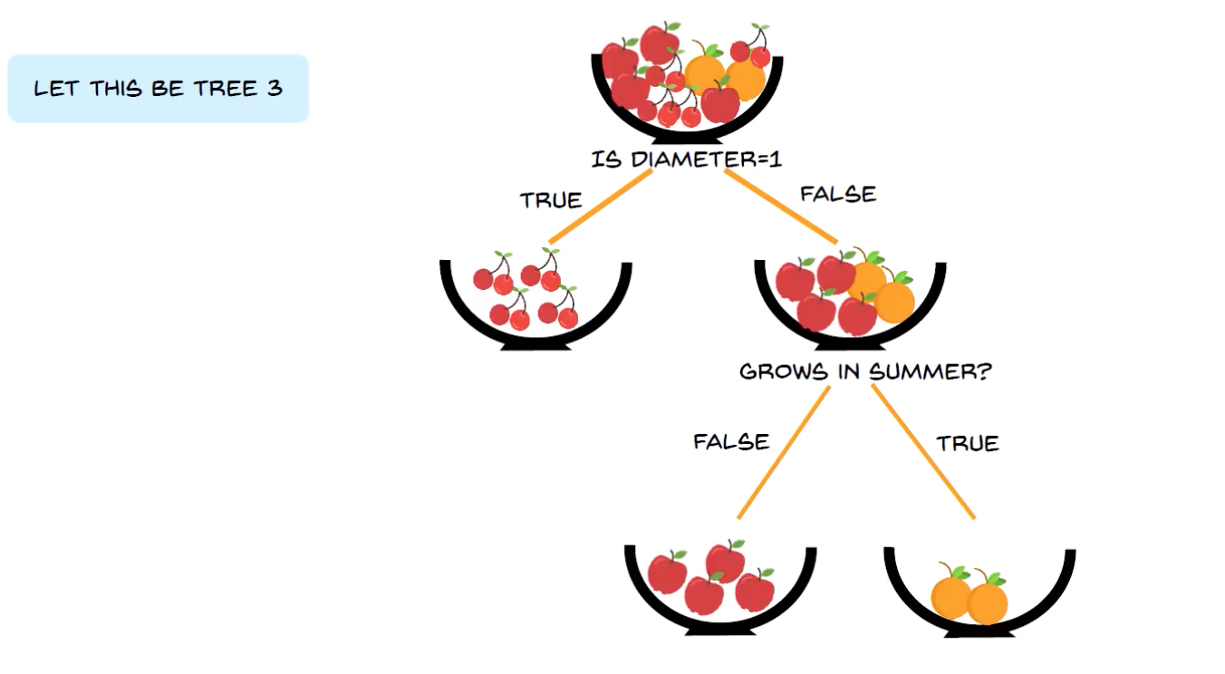
Decision Tree 3

Slide 29
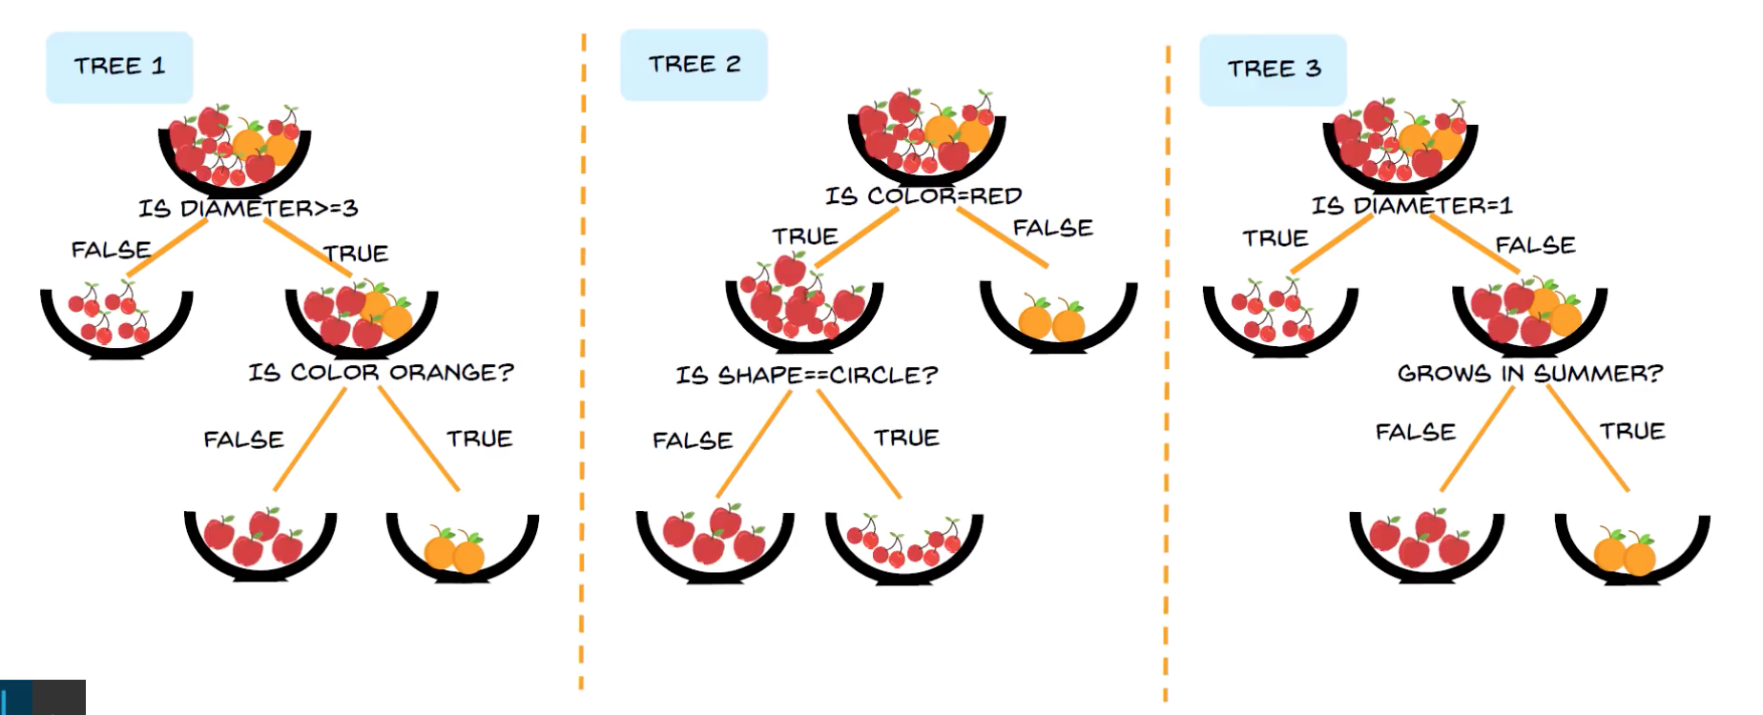

Slide 30
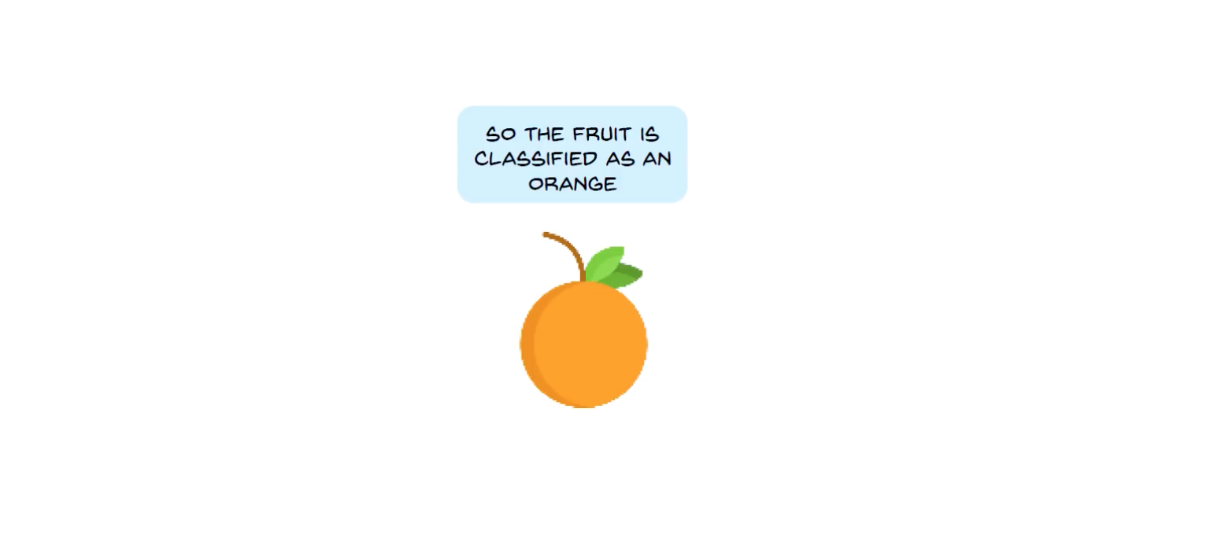
FINAL VOTE

Slide 31
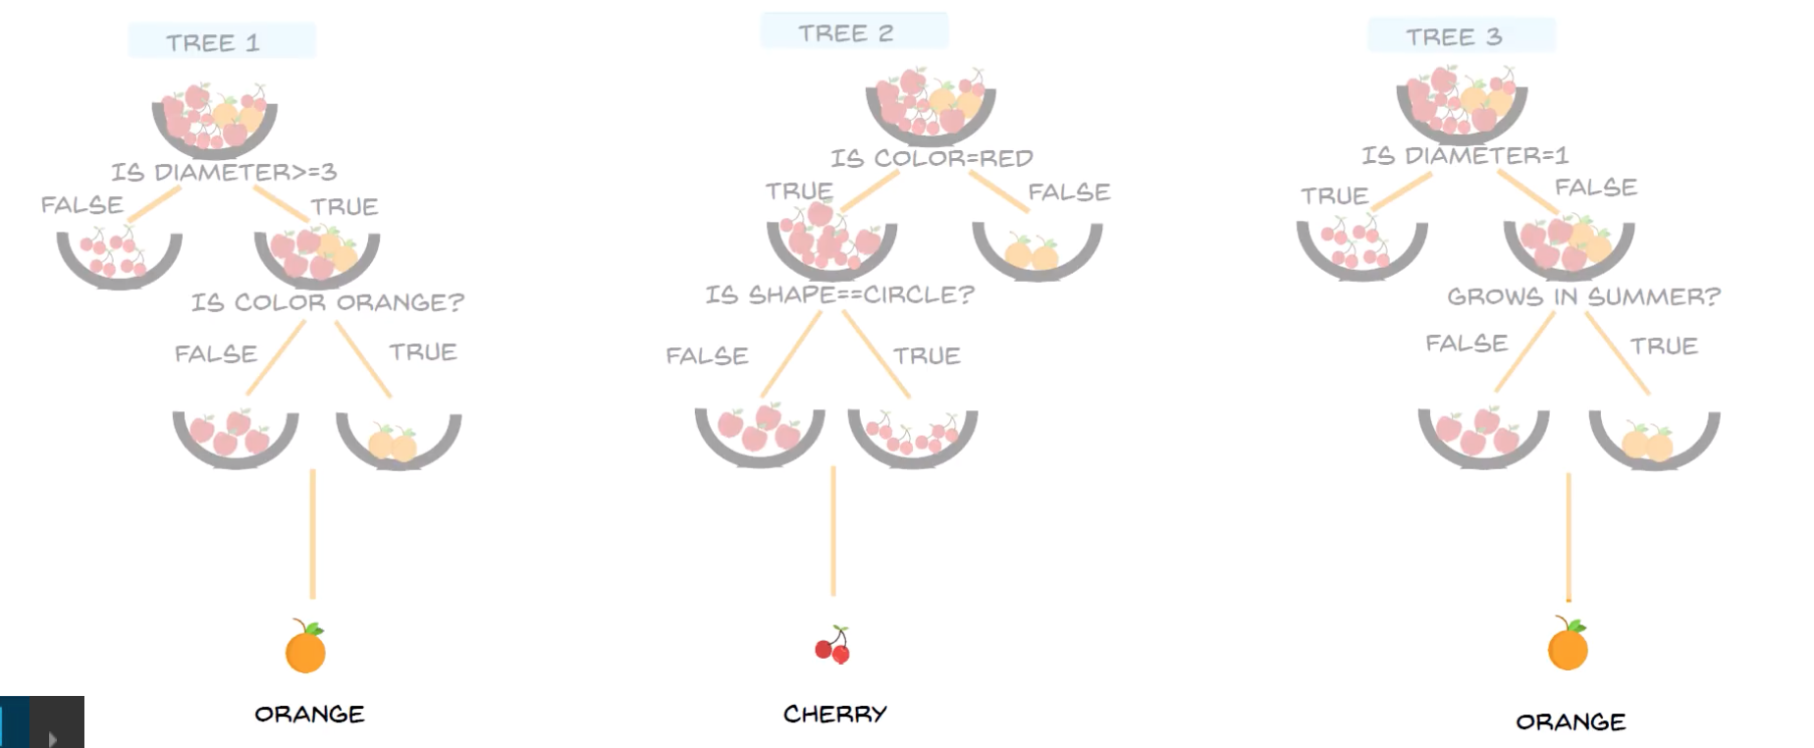

Slide 32
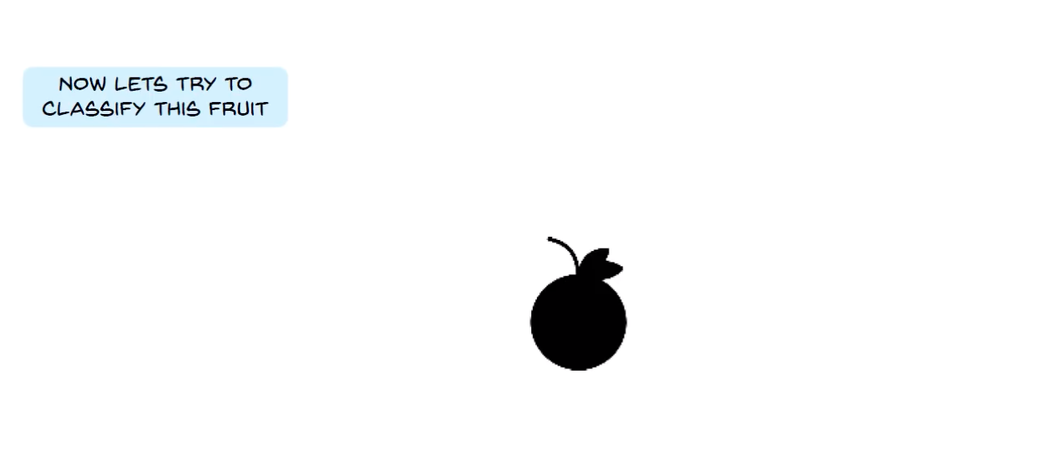
Fruit without Color

Slide 33
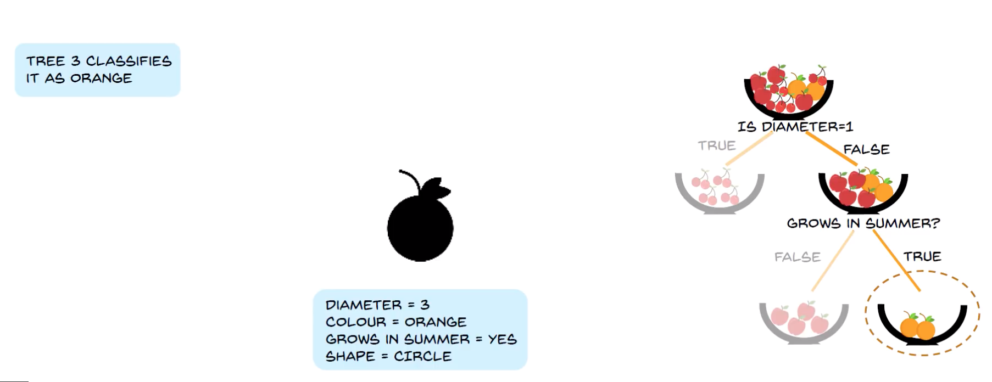
Trees 3 classify

Slide 34
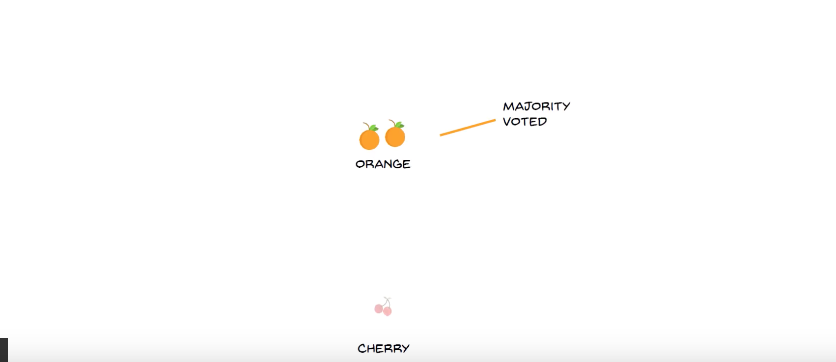
MOJORITY VOTE

Slide 35
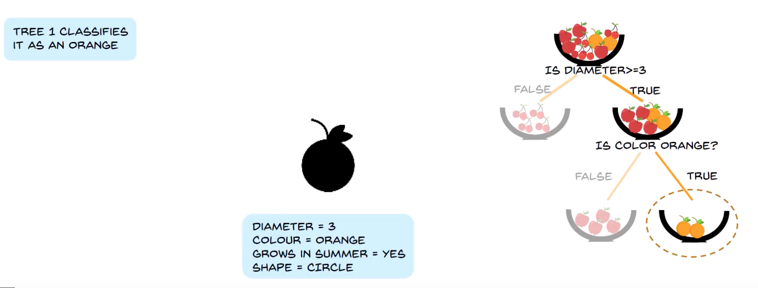
Tree 1 thinks it is an orange

Slide 36
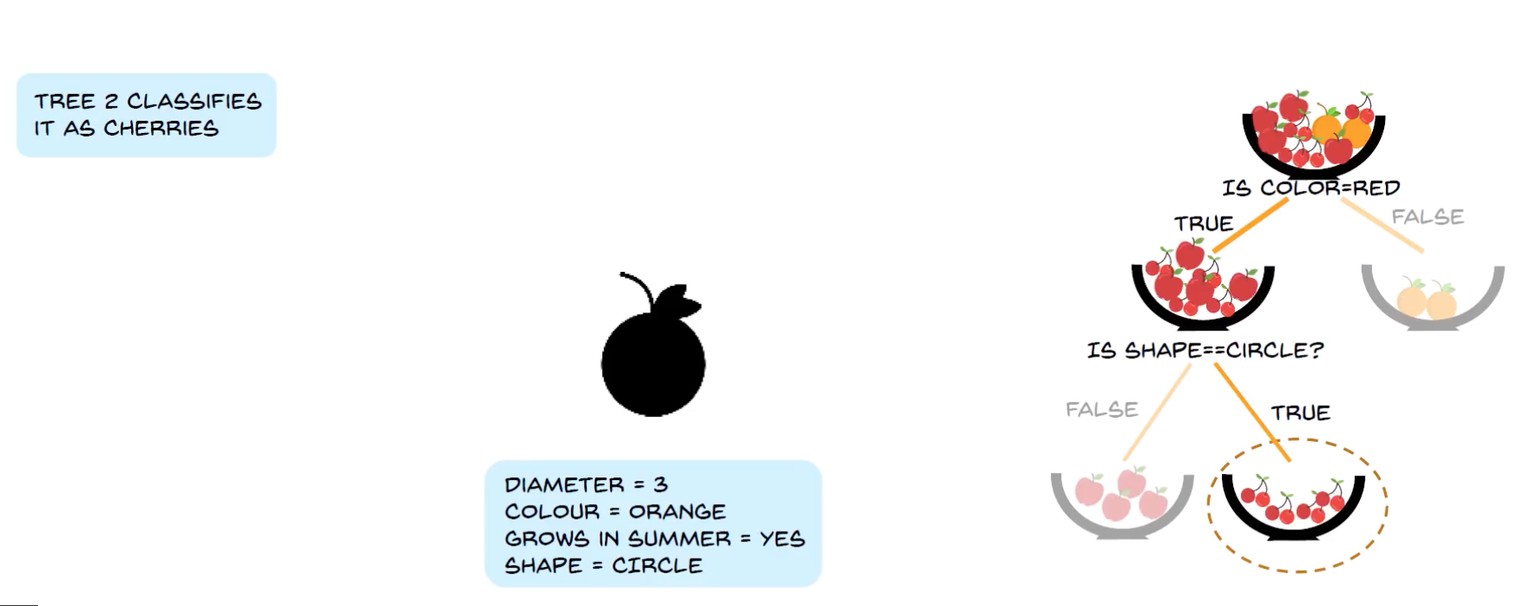
Tree 2 classifies as Cherrie

Slide 37
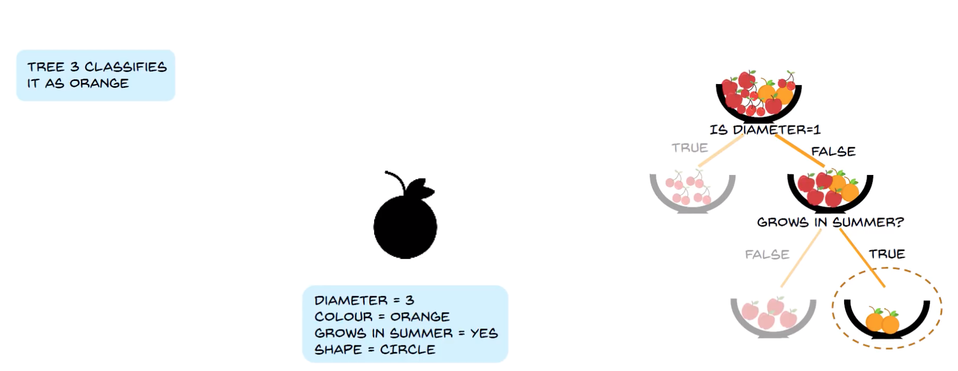
Tree 3 thinks it is an orange

Slide 38
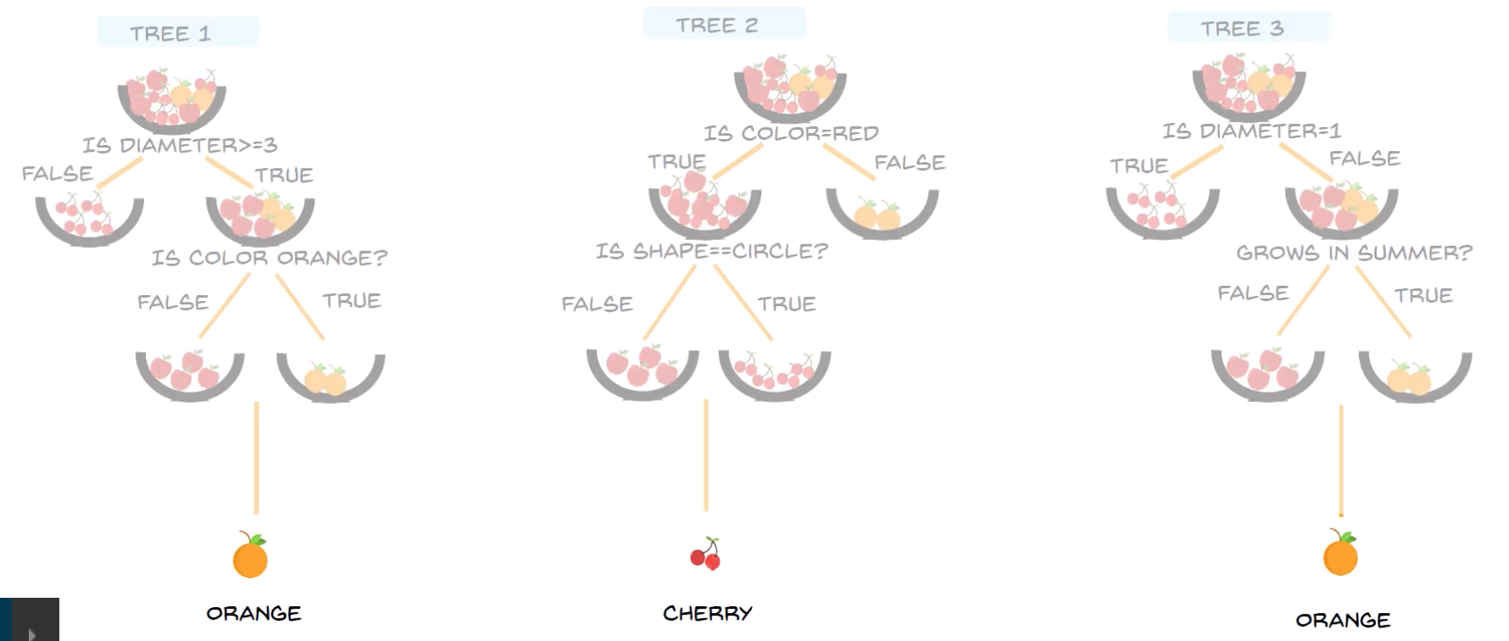
FINAL DECISION

Slide 39
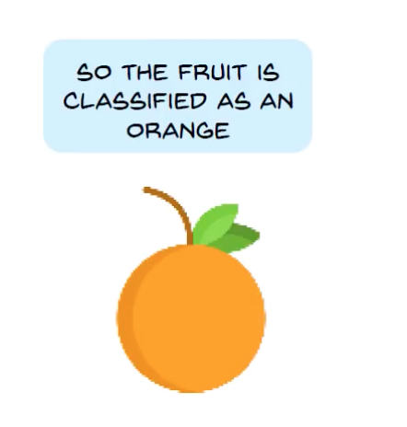
CONCLUSION

